Slide 1

INVERSE OF A FUNCTION KAZIBA STEPHEN
24th January 2025

Slide 2
LEARNING OUTCOMES
By the end of this lesson you should be able to find the inverse of a function.

Slide 3
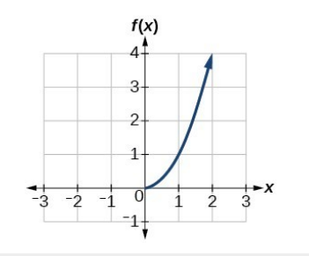
Find the inverse of the function

Slide 4
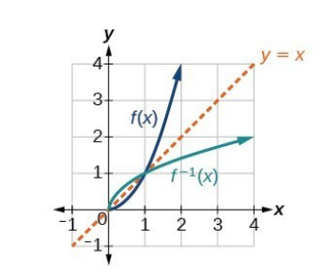

Slide 5
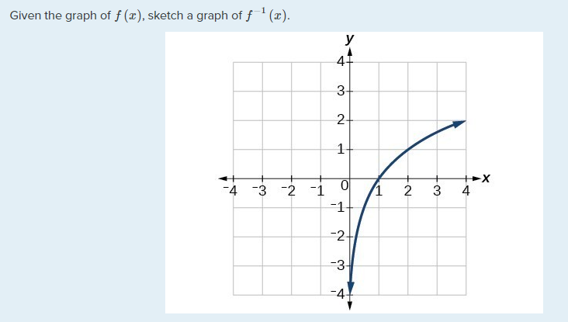

Slide 6
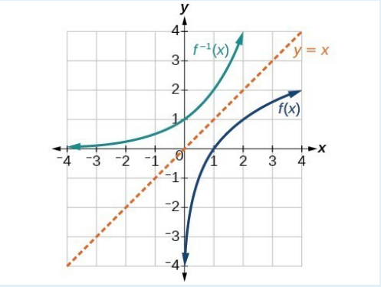

Slide 8
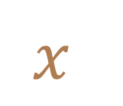

INVERSE FUNCTION MACHINE
$$x$$
X 5
- 2
$$x$$

Slide 9


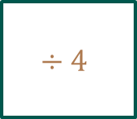

INVERSE FUNCTION MACHINE
$$x$$
x$5$
- 2
$$÷4$$
$$x$$

Slide 10
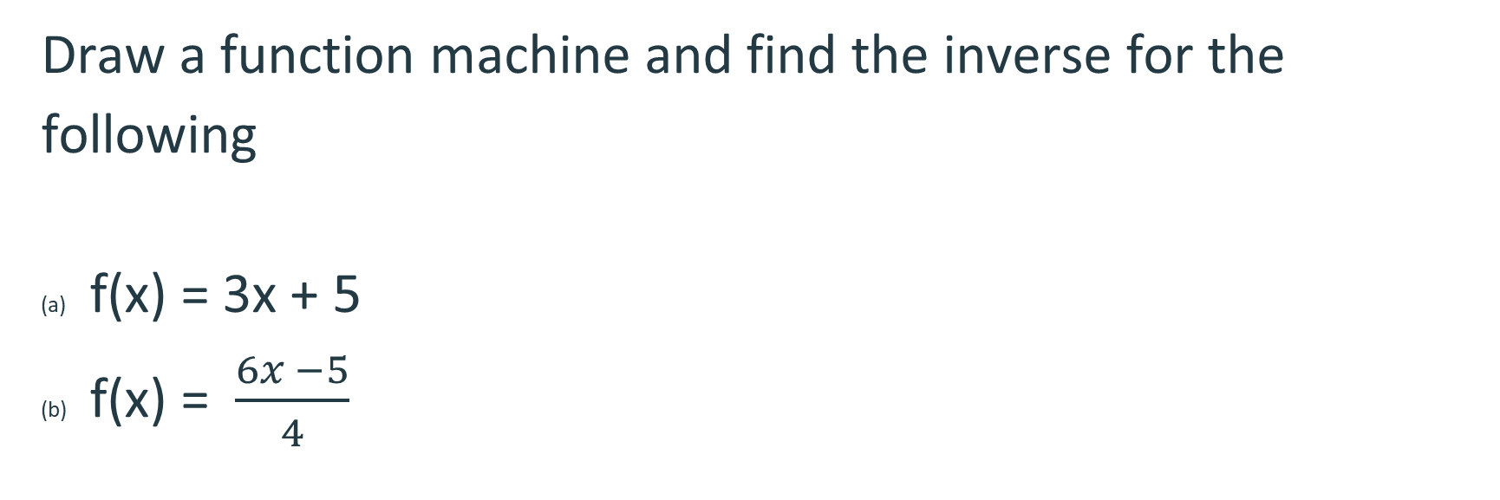
Activity
Draw a function machine and find the inverse for the following
f(x) = 3x + 5
f(x) =$\frac{6x −5}{4}$

Slide 11
Finding inverse functions algebraically

Slide 12
ACTIVITY

Slide 13
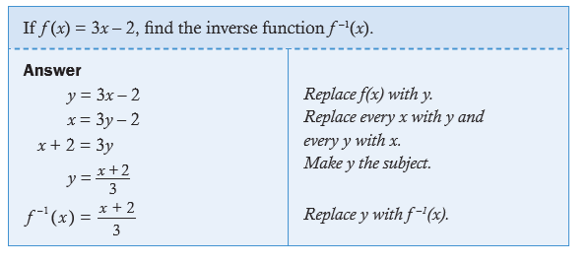

Slide 14
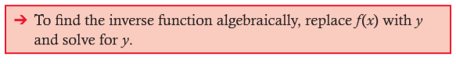
NOTE
The inverse function of a given function f is the reflection of the graph y = f (x) in the line y = x, which swaps x and y. So in Example above we swapped x and y, and then made y the subject.

Slide 16
Find the value of $h^{−1}(30)$ given $h(x)=x^{2}+5$.

Slide 21






Thank You

